Slide 1


SMART INDIA HACKATHON 2026
Problem Statement ID – 26090
Problem Statement Title- Al-Driven Market Linkage and Smart Cataloging Mobile Application for Marginalized Artisans
Theme- Heritage and Culture
PS Category- Software
Team ID-
Team Name- Vanguard

Slide 2
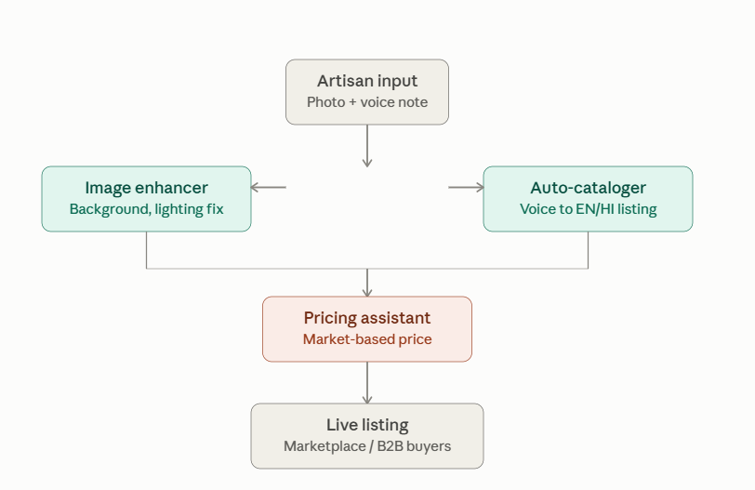
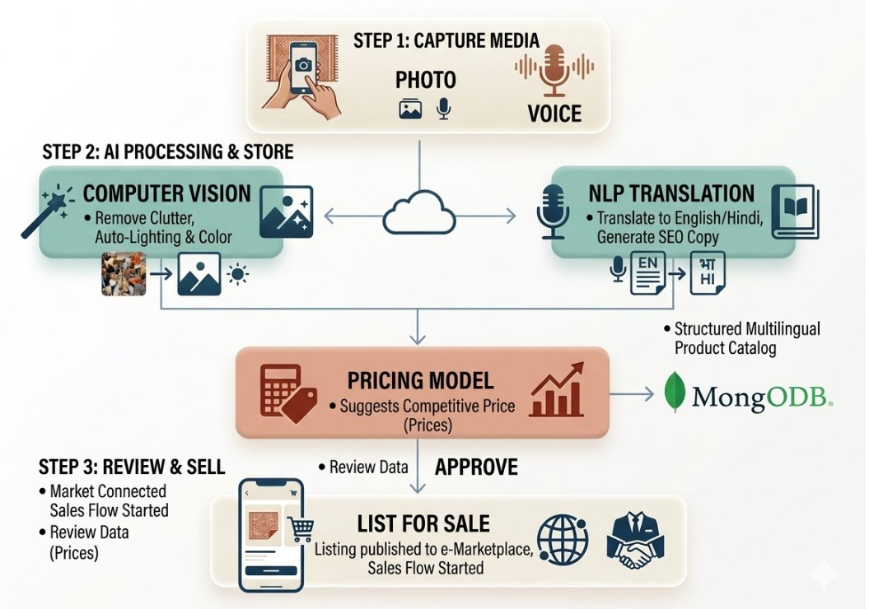
CRAFTCONNECT
Vanguard
Detailed explanation of the proposed solution
Voice-First Application: Photo capture + spoken description yields a fully ready e-commerce listing in seconds.
Auto-Cataloger: Generates SEO titles, localized descriptions, and AI-driven market pricing.
How it addresses the problem
Zero Tech Barrier: Requires no typing, complex image editing, or prior e-commerce skills.
AI Skill Replacement: Replaces missing photography, copywriting, and pricing expertise effortlessly.
Continuous Storefront: Enables year-round digital sales vs. sporadic physical craft fairs.
Innovation and uniqueness
Live Pipeline: Working end-to-end voice-to-listing pipeline demoed on authentic handicraft items.
Explainable Pricing: Price recommendations backed by transparent market rationale.
Multilingual First: Engineered for regional languages and low-literacy artisan sellers.

Slide 3
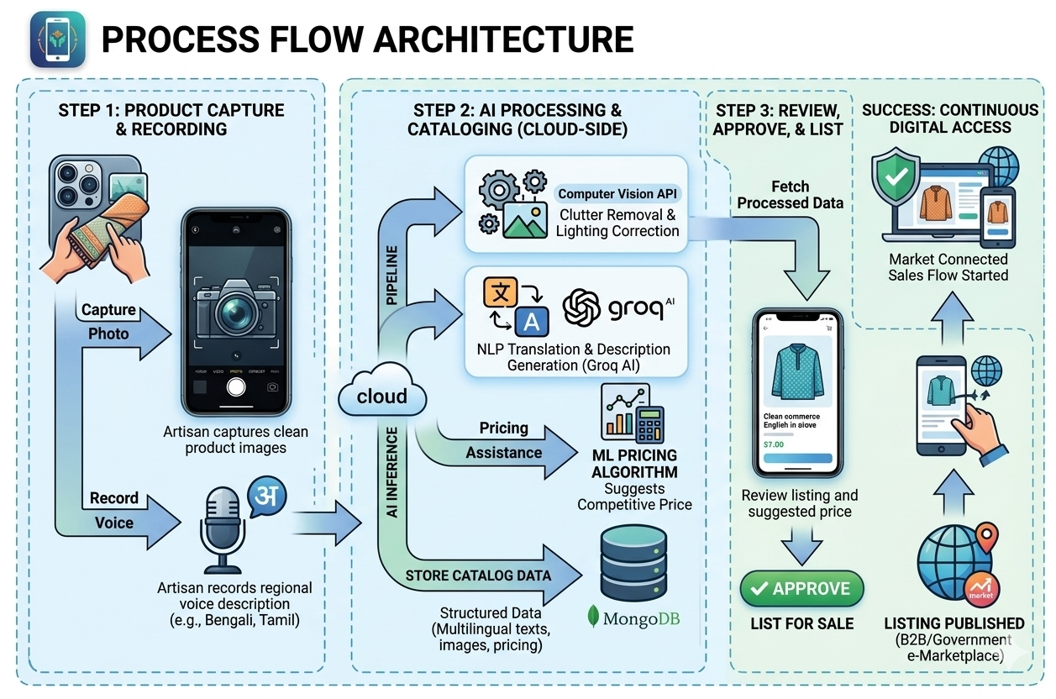
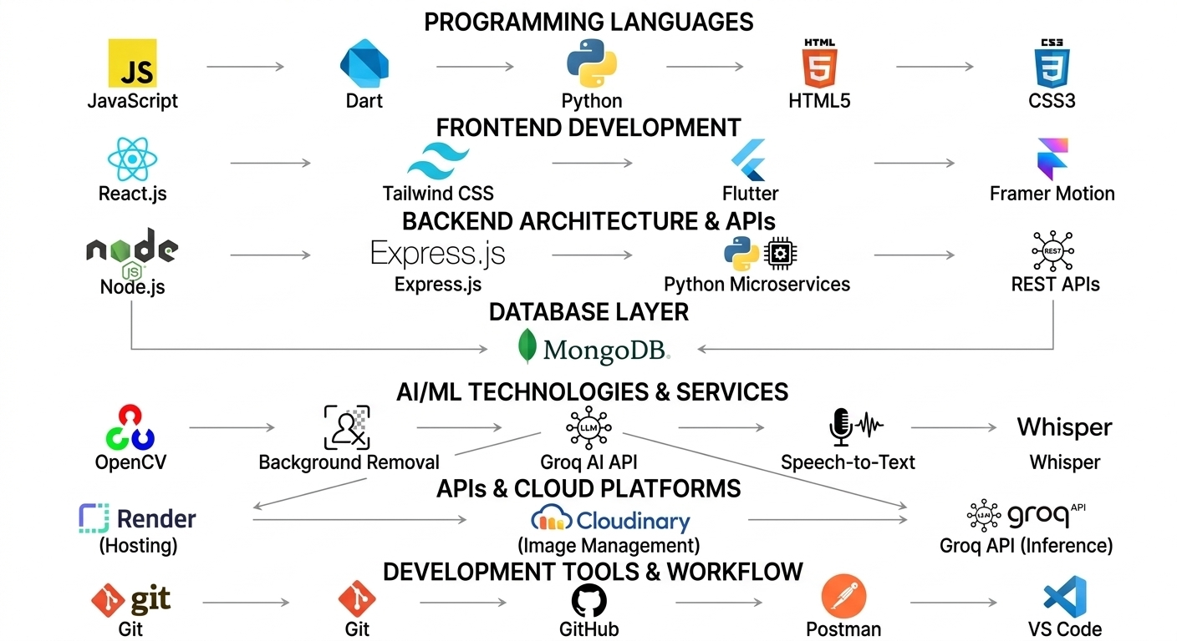
TECHNICAL APPROACH
Vanguard
Technology Stack

Slide 4
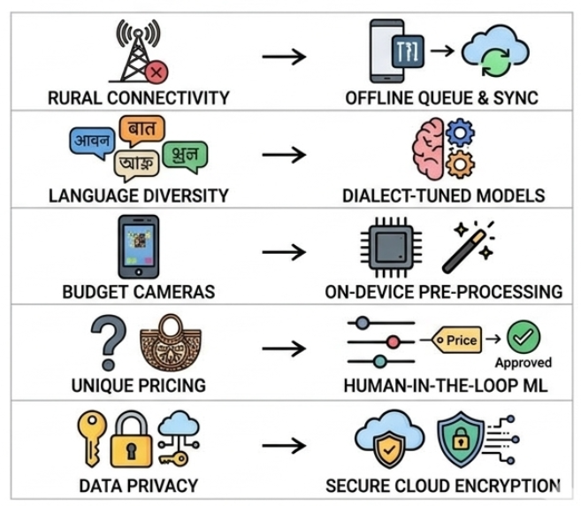
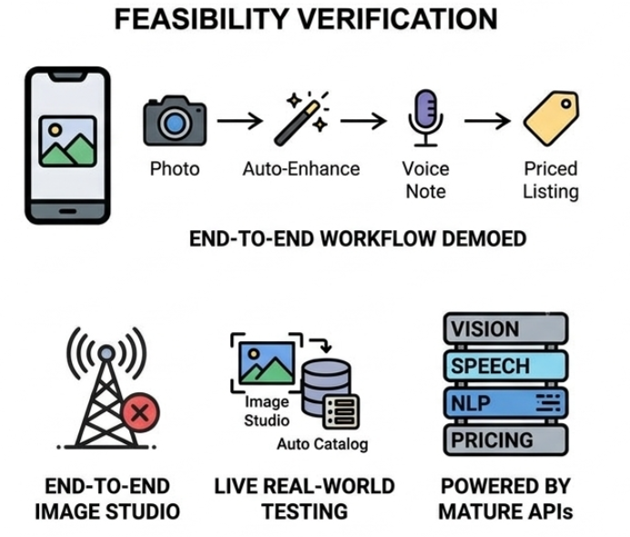
FEASIBILITY AND VIABILITY
Vanguard
Analysis of the feasibility of the idea
Working prototype already built and demoed end-to-end: photo → AI enhancement → voice → priced listing.
AI Image Studio and Auto Catalog run live on real handicraft photos and voice notes.
Built on mature AI services (vision, speech-to-text, NLP, pricing logic).
Challenges & risks vs. mitigation strategies

Slide 5
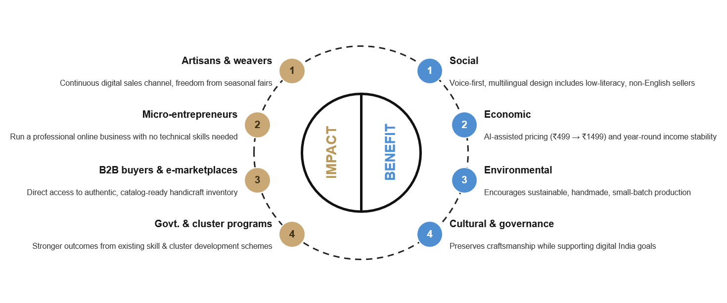
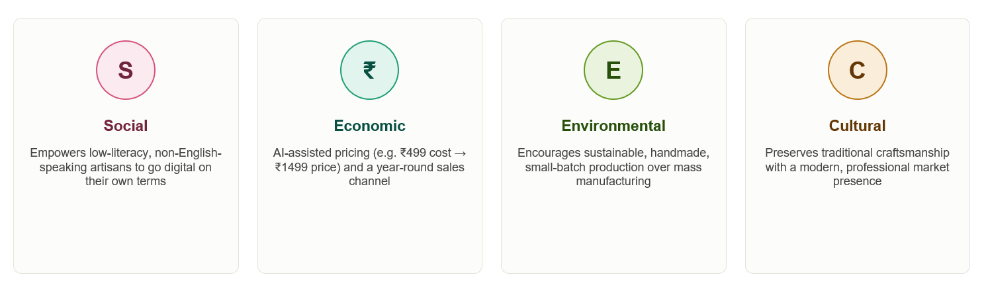
IMPACT AND BENEFITS
Vanguard
Potential impact on the target audience
Continuous digital storefront instead of relying on periodic fairs
No technical/design skills needed — artisans just speak and photograph
Direct access to B2B buyers and government e-marketplaces
Benefits of the solution

Slide 6
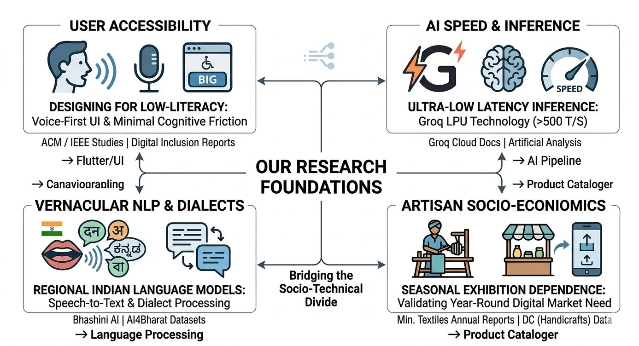
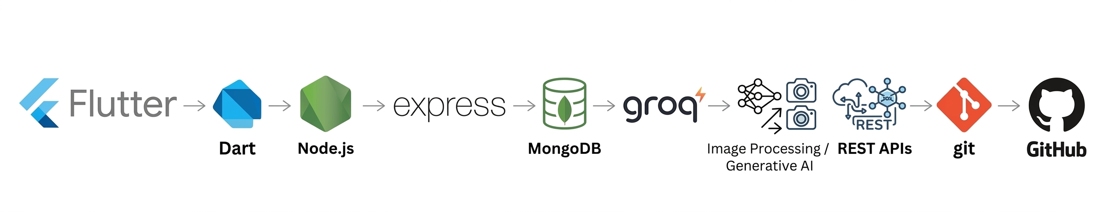
RESEARCH AND REFERENCES
Vanguard
Flutter Documentation - https://docs.flutter.dev/
Dart Programming Language Documentation - https://dart.dev/guides
Flutter Material Design Components - https://m3.material.io/
FastAPI Documentation - https://fastapi.tiangolo.com/
MongoDB Documentation - https://www.mongodb.com/docs/
Motor – Asynchronous MongoDB Driver for Python - https://motor.readthedocs.io/
Cloudinary Image Management Documentation - https://cloudinary.com/documentation
Groq API Documentation - https://console.groq.com/docs
Flutter Image Picker Package - https://pub.dev/packages/image_picker
Flutter Shared Preferences Package - https://pub.dev/packages/shared_preferences
OWASP Authentication Security Guidelines- https://cheatsheetseries.owasp.org/cheatsheets/Authentication_Cheat_Sheet.html
OWASP Password Storage Guidelines- https://cheatsheetseries.owasp.org/cheatsheets/Password_Storage_Cheat_Sheet.html
Groq AI

